Slide 1
Empowering Customers: Why Microsoft Loves Linux
Bruno Medina
Open Source and Education
TED - Microsoft Corporation

Slide 2



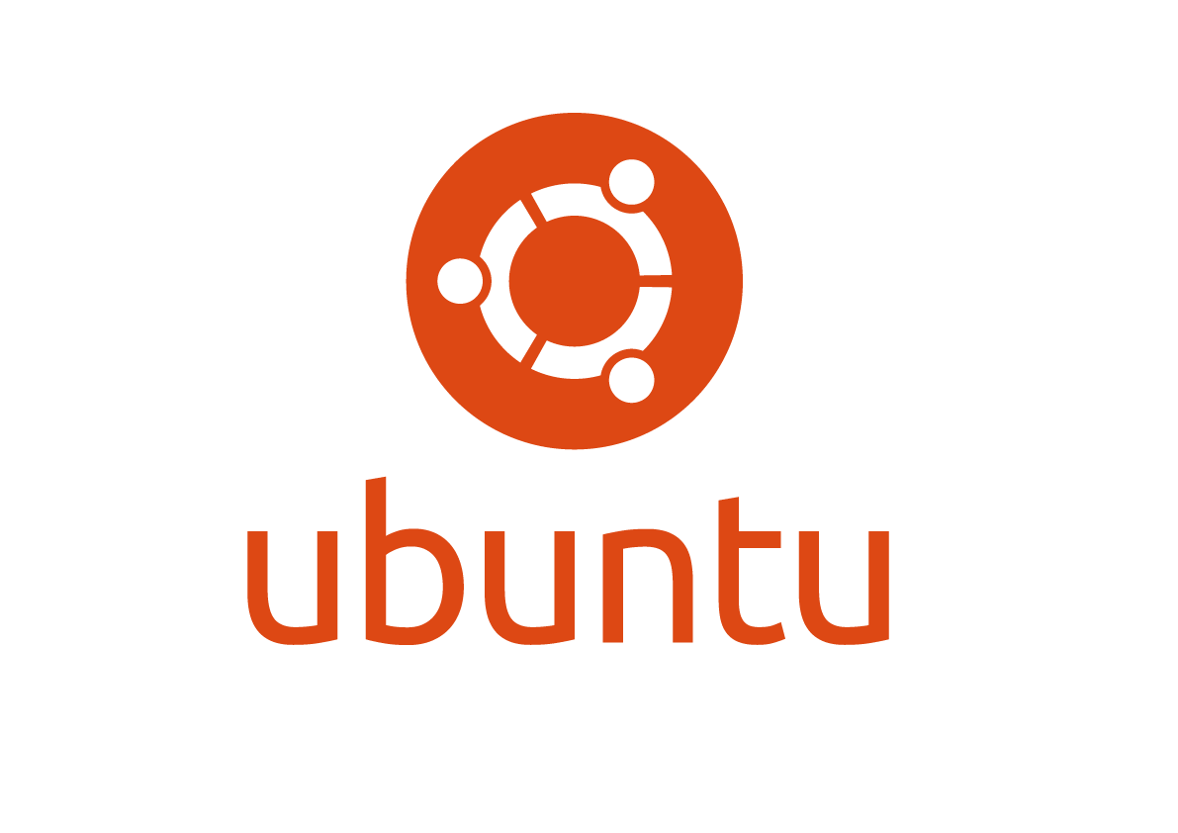
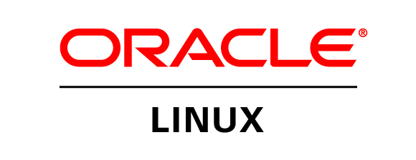



Linux on Azure – Endorsed distributions
Notes:
These are the only endorsed linux distributions
https://azure.microsoft.com/en-us/documentation/articles/virtual-machines-linux-endorsed-distros/

Slide 3
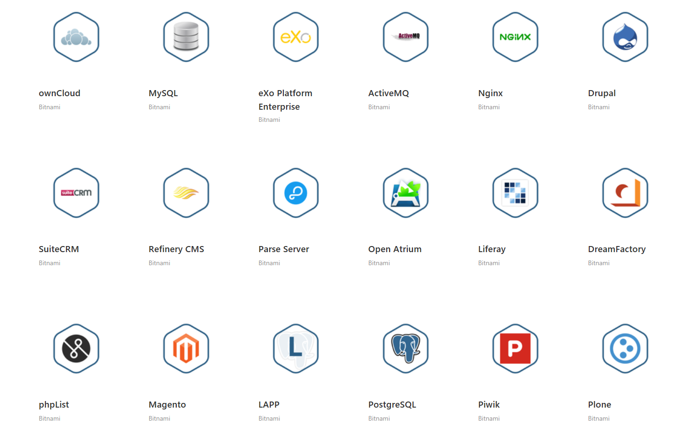
Marketplace
Notes:
Everything that you are deploying is either coming from the Azure Marketplace

Slide 4
LINUX is in everything

Slide 5

Popular workloads
Websites and API
E-commerce, Mobile Apps API, CMS, Web Apps, BI dashboards, CRM
HPC / Big data computing
Rendering, Financial risk modeling, Engineering design and Simulation, Genomics research, Blockchain, Machine Learning, Artificial Intelligence, MPI, Predictive Modeling, Data Science
Storage
MongoDB, MySQL / MariaDB, Neo4j, Cassandra, MariaDB, Redis, PostgreSQL, MS SQL, CouchDB, Hbase
Languages
Python, Ruby, Elixir, Go, PHP, Java, JS, Haskell, Scala, R
Notes:
These are the only endorsed linux distributions
https://azure.microsoft.com/en-us/documentation/articles/virtual-machines-linux-endorsed-distros/

Slide 6
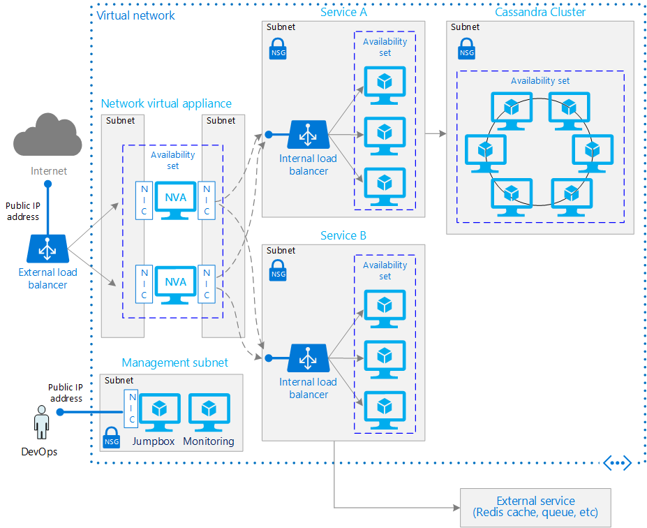
ARM Templates save the day
armviz.io
resources.azure.com
ARMclient
Notes:
The good news is that we have ARM to help us deploy
all these intrincated and
complex architectures
These templates are json
And easy to use
Decoupleable

Slide 7

Bitnami ARM solution templates
Wordpress
MongodDB
Jenkins
Drupal
Redmine
Magento
Notes:
Or it comes from ARM templates
The better news is that we have Partners like bitnami
ARM SOLUTION templates
They take care of
- Test them
- Upgrade them
- And roll them out

Slide 8
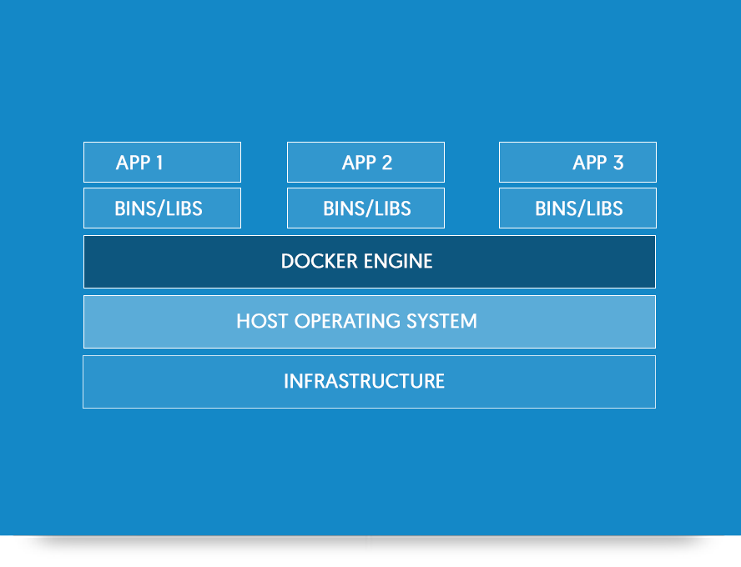
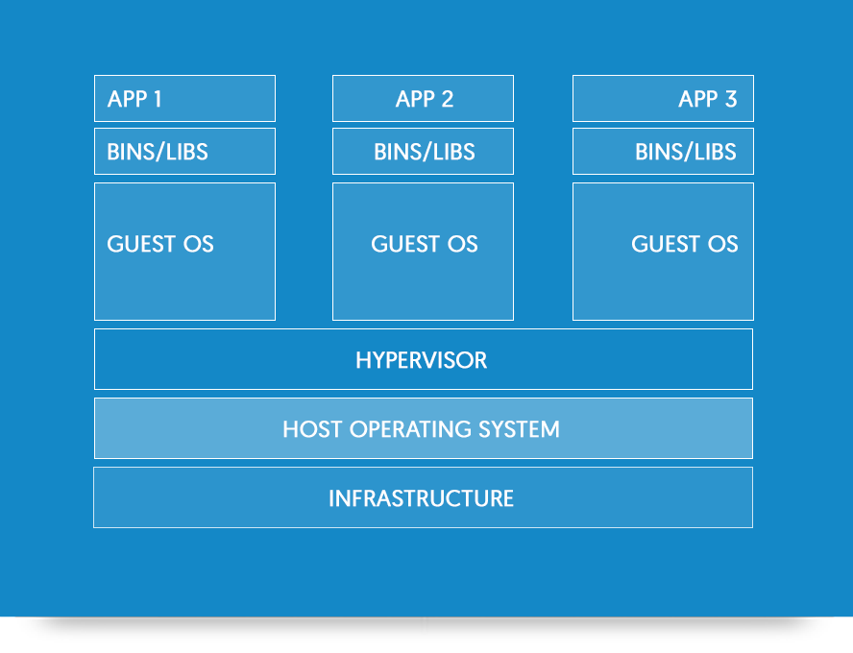
Containers
Notes:
No, but that is what the whole containers and devops
frenezi is all about
The main idea is to encapsulate workloads
So you can easily deploy a
LAMP, MEAN, RoR, LNMP stack

Slide 9
Tuxedo
tuxusers@microsoft.com

Slide 10
Our Open Source Strategy
Meet where customers are
Deliver the most productive and trustworthy cloud services platform that enables developers using any framework on any device or OS to create and power the world's apps and services that run anywhere
Best cloud platform for partners to succeed

Slide 11



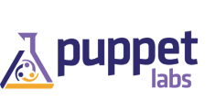
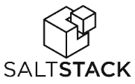







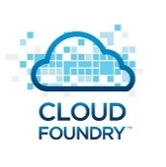





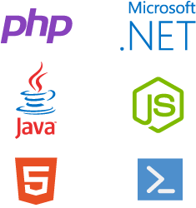
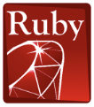







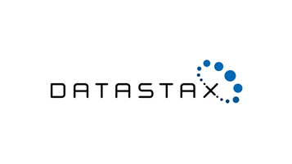


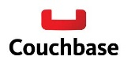

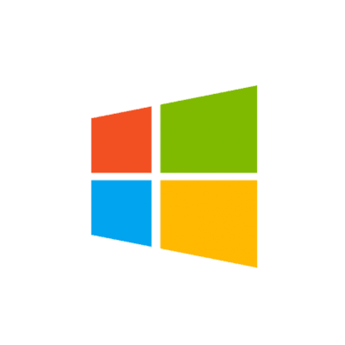






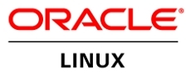
OLD partnership opportunity with Microsoft…..limited to our products
MS Product Centric
Management
System Center
Applications
Dynamics
SharePoint
Exchange
Application Frameworks
.NET
Databases
SQL Server
Infrastructure
Notes:
The reality is that in our industry, open source is pervasive. Just take a look at the technology stack – from the operating system up to the application, there are seemingly countless options in the open source space. Developers love open source, and the majority of those building new cloud based startups are also using open source technologies. Customers leverage it to be disruptive in their vertical, and our competitors are very effective in using it to capture share of wallet in the cloud.
Until now, we have successfully monetized a tight, vertically integrated family of technologies. But if we want a larger share of wallet in the cloud, it’s evident that we need to look beyond our only stack only and monetize open source technologies on Azure. By FY17 OSS is expected to represent an $18B opportunity in the IaaS and PaaS market. A large portion of private cloud and the majority of public cloud today is powered or influenced by open source.

Slide 12

New Era for Microsoft…..with New Partnership Whitespace
Public Cloud
Hybrid Cloud
Private Cloud
Our Cloud Opportunity $$$
Management
System Center
Applications
Dynamics
SharePoint
Exchange
Application Frameworks
.NET
Databases
SQL Server
Infrastructure

Slide 13
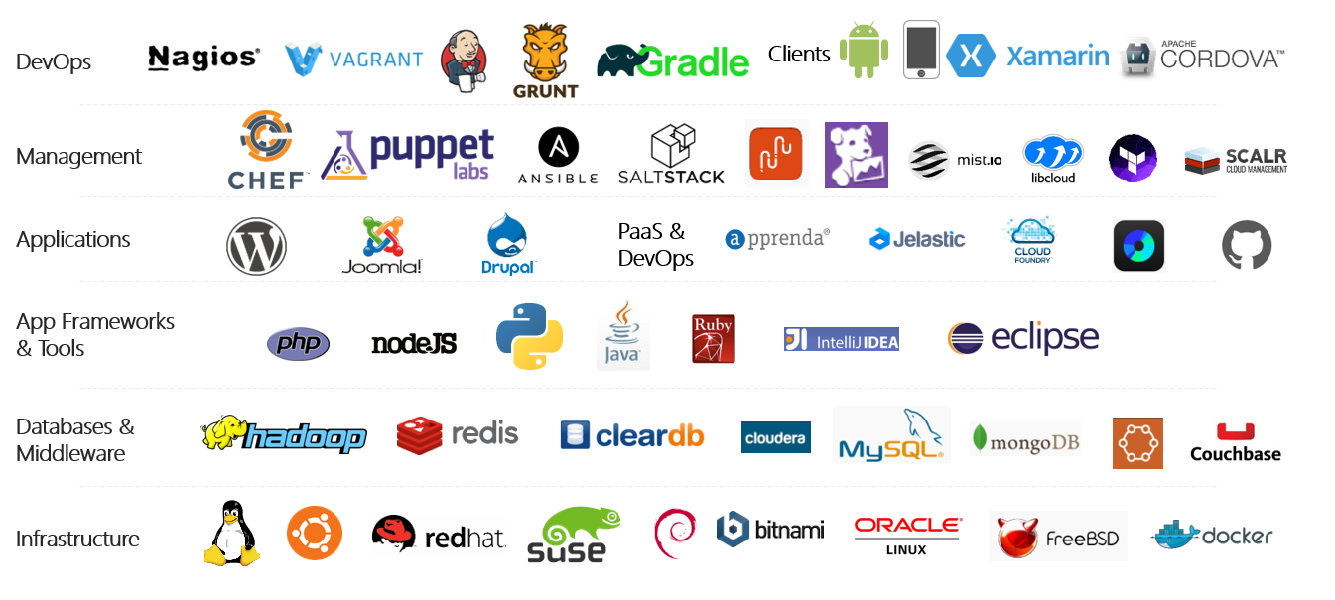
Azure is an open cloud
Notes:
Azure is becoming an open cloud
Several Linux distros supported
Enterprise Linux ( charge an additional $.06 an hour for support )
Red Hat
SUSE
Other Distros
Ubuntu
CoreOS
Debian
CentOS
FreeBSD
Oracle Linux

Slide 14
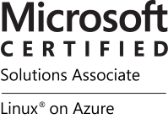
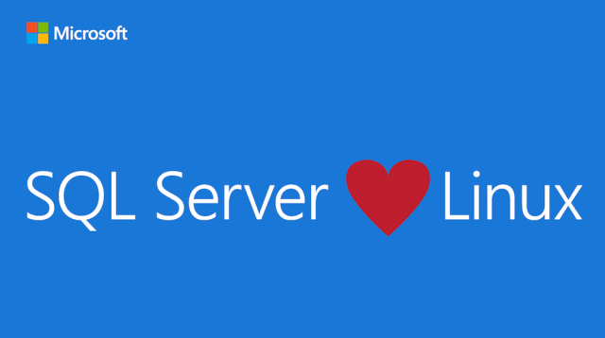
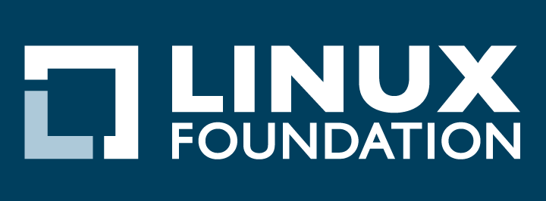


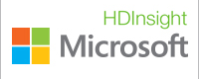


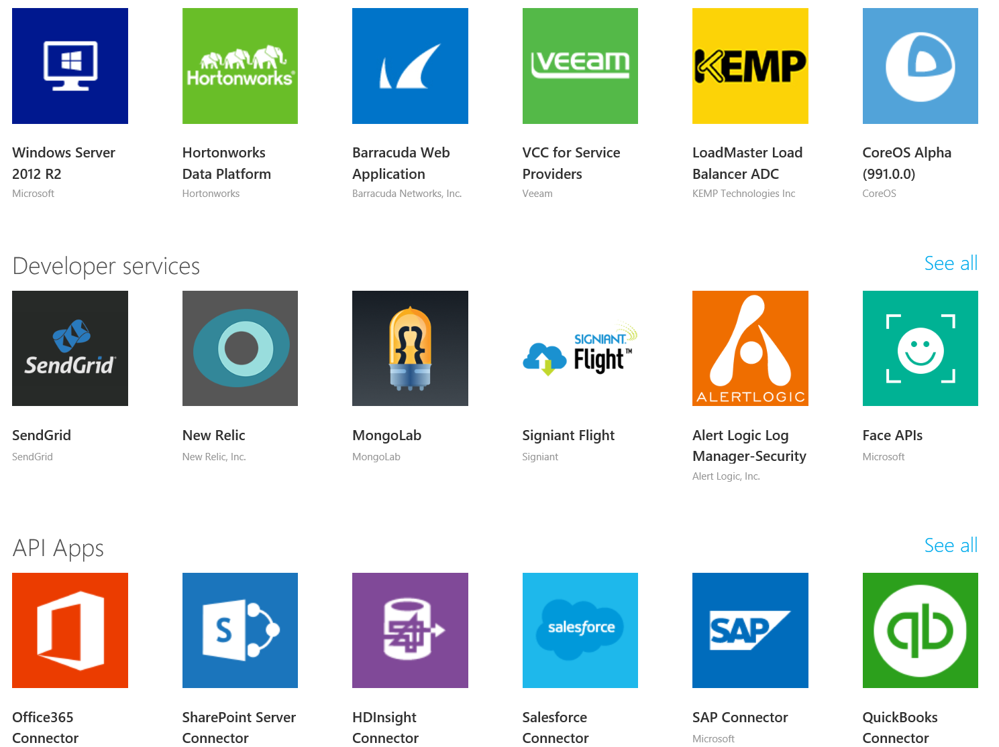
Momentum at Microsoft…
SQL Server on Linux
(Preview today, GA in mid-2017)
In partnership with the Linux Foundation, Microsoft releases the Microsoft Certified Solutions Associate (MCSA) Linux on Azure certification.
Red Hat - Microsoft Partnership
(Nov 2015)
Microsoft Employees
Ross Gardler: President Apache Software Foundation
HD Insight PaaS on Linux GA (Sep 2015)
Microsoft joins Eclipse Foundation. (Eclipse is the largest OSS Dev Toolset)
(Mar 2016).
Azure Marketplace
60% of all images in Azure Marketplace are based on Linux/OSS
Windows Subsystem for Linux
Run Linux on Windows natively
(March 2016)
1 out of 4 VMs on Azure runs Linux, and getting larger every day
28.9% of All VMs are Linux
>50% of new VMs
1 out of 4 3
bash
467,484,471+
Lines Contributed
Open Source Hub

Slide 15
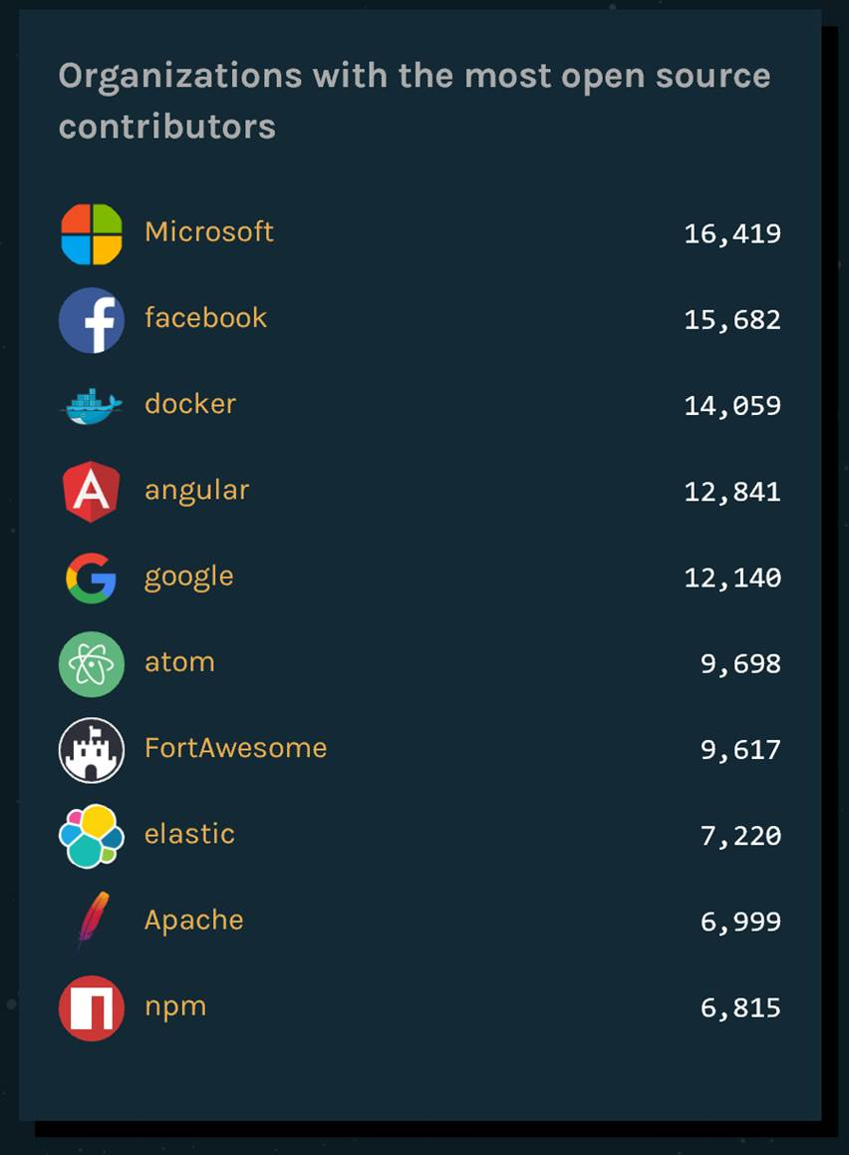
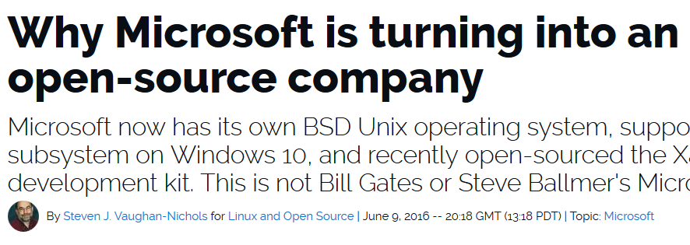
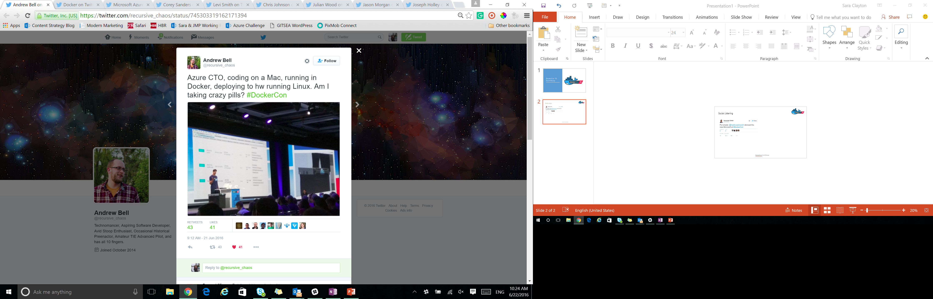
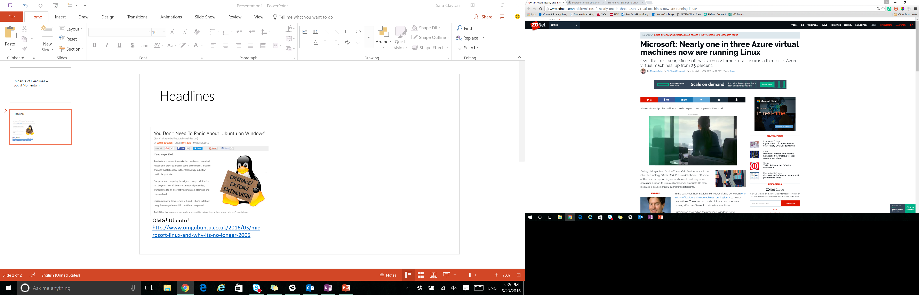
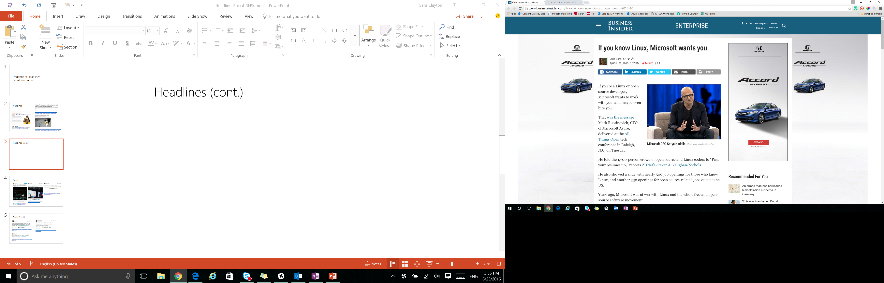

Slide 16
Delivering the hybrid cloud
Available
Today
Available
Today
Available
Today
Available
Today
Available
Today
Integrated support services for hybrid clouds, including Red Hat® products in on-premises customer environments and on Microsoft Azure
Microsoft .NET integration and availability with Red Hat Enterprise Linux®, including Atomic Host, and OpenShift by Red Hat
Red Hat products offered and supported on Microsoft Azure
Microsoft Windows supported on Red Hat Enterprise Linux OpenStack® Platform and Red Hat Enterprise Virtualization
Management tooling integration for open hybrid cloud implementations with Red Hat CloudForms
Microsoft joins the Red Hat Certified Cloud and Service Provider program (CCSP)
16
Notes:
Within one week of making this market-leading announcement, Red Hat and Microsoft delivered on 3 of the 5 major elements.
As we look to the future, we are committed to supporting enterprise customers and ISVs as we make the migration to the enterprise cloud.
16

Slide 17




Integrated Support
Red Hat and Microsoft have created an industry-changing integrated support model for customers using Red Hat solutions in Azure. We are working side-by-side to solve common problems and to provide the enterprise-grade support that customers rely on in their datacenters.
Highlights:
Red Hat participation in Azure forums
Red Hat & Microsoft security response team collaboration
Support staff from Red Hat & Microsoft co-located @Redmond
Integrated ticketing systems
Red Hat Technical Account Management & Microsoft Premier Services

Slide 18
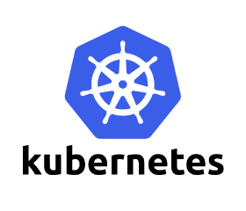


Container Solutions in Azure
Solutions that run on Linux in Azure
Platforms:
Red Hat OpenShift
Kubernetes
Docker Datacenter
Swarm -
Deis
Kubernetes – Open Source Heroku
DC / OS
Mesos – Mesosphere Enterprise Offering
ACS
Mesos, Swarm, and Kubernetes coming soon!
Orchestrators Now Supported in Azure

Slide 19
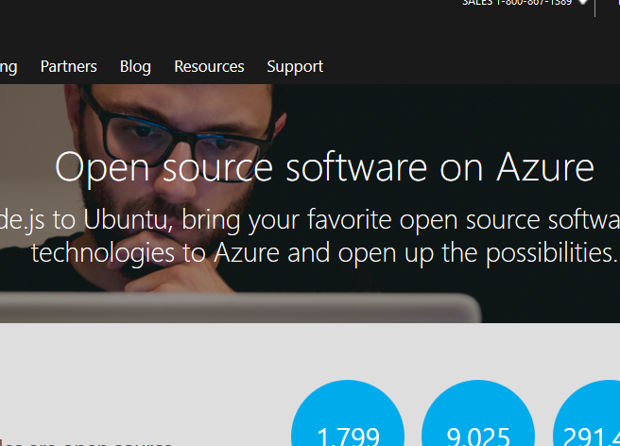
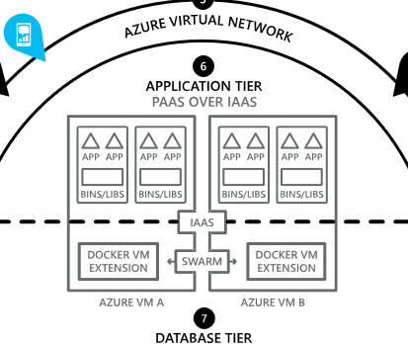
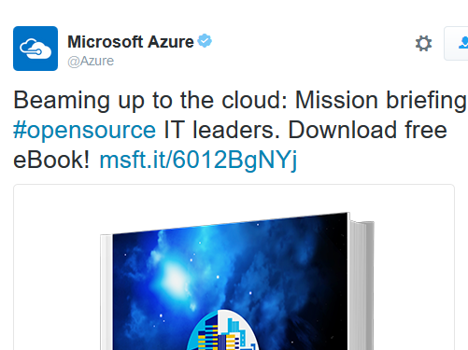
Sharing with customers
Open Source Hub
Open Cloud Cases
Open Cloud Book
azure.com/opensource
Stay informed, learn and get involved with open source in Azure
aka.ms/opencloudcases
Explore blueprints and download whitepapers and architecture diagrams
aka.ms/opencloudbook
Learn how organizations are innovating with and exploring open source in the cloud

